Slide 1

How and why neurons fire

Slide 2
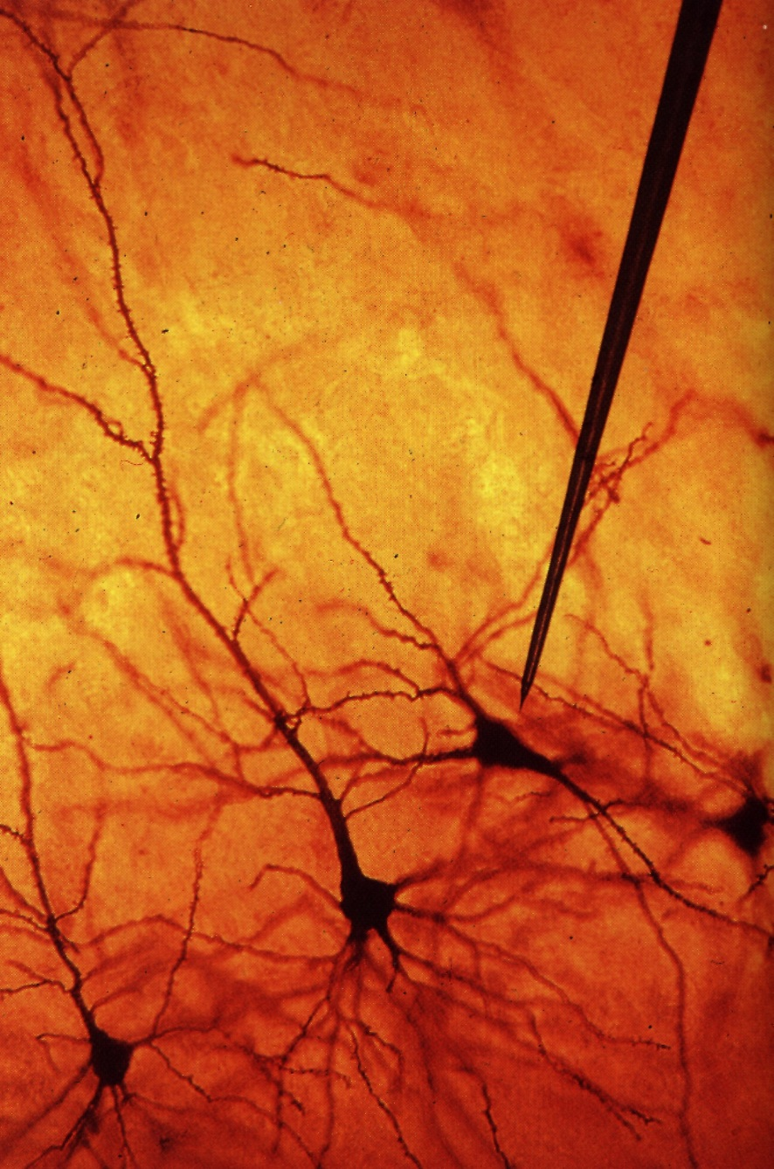
Neurophysiological Background
“The Neuron “
Contents:
Structure
Electrical Membrane Properties
Ion Channels
Actionpotential
Signal Propagation
Synaptic Transmission

Slide 3
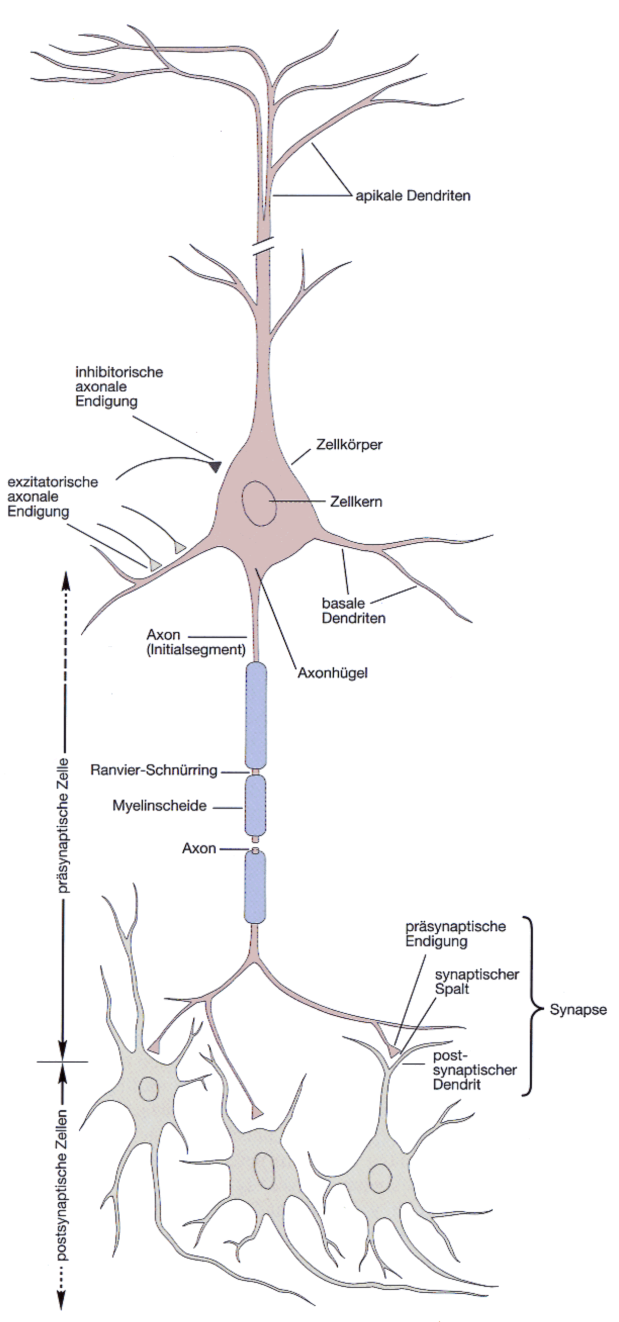
Structure of a Neuron:
At the dendrite the incoming
signals arrive (incoming currents)
At the soma current
are finally integrated.
At the axon hillock action potential
are generated if the potential crosses the
membrane threshold.
At the axon hillock action potential
are generated if the potential crosses the
membrane threshold.
At the axon hillock action potential
are generated if the potential crosses the
membrane threshold.
At the axon hillock action potential
are generated if the potential crosses the
membrane threshold.
The axon transmits (transports) the
action potential to distant sites
CNS
At the synapses are the outgoing
signals transmitted onto the
dendrites of the target
neurons
Systems
Areas
Local Nets
Neurons
Synapses
Molekules

Slide 4
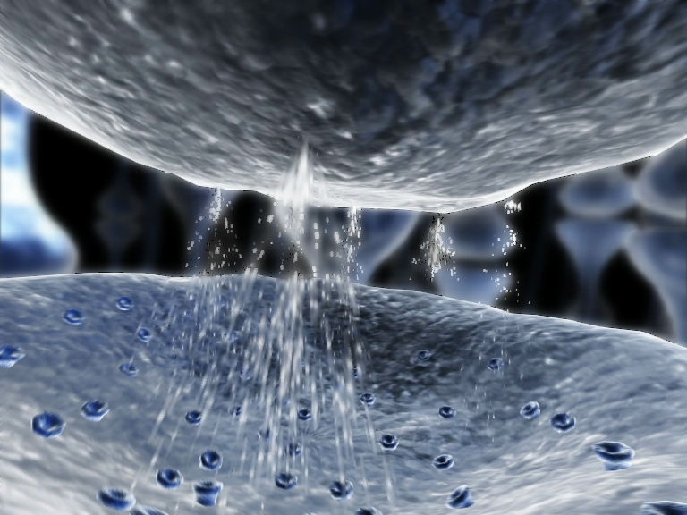
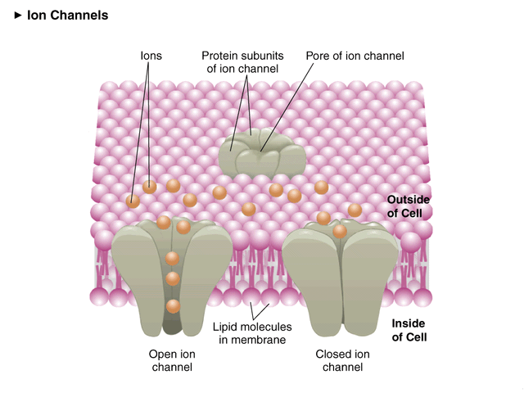
Selective ion channels

Slide 5
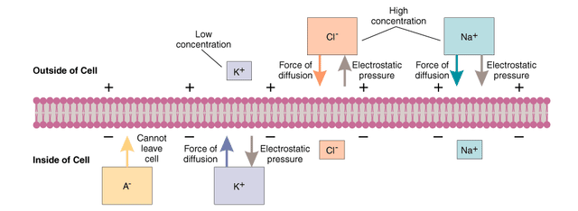
Membrane potential
What does a neuron need to fire?
Depends on a few ions:
Potassium (K+)
Sodium (Na+)
Chloride (Cl-)
Calcium (Ca++)
Protein Anions (A-)

Slide 6
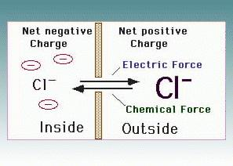
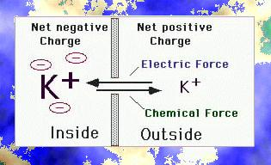
In the absence of active channels selective for ions, we find two forces:
passive diffusion (from high to low concentrations)
electric forces (charge balance)

Slide 7
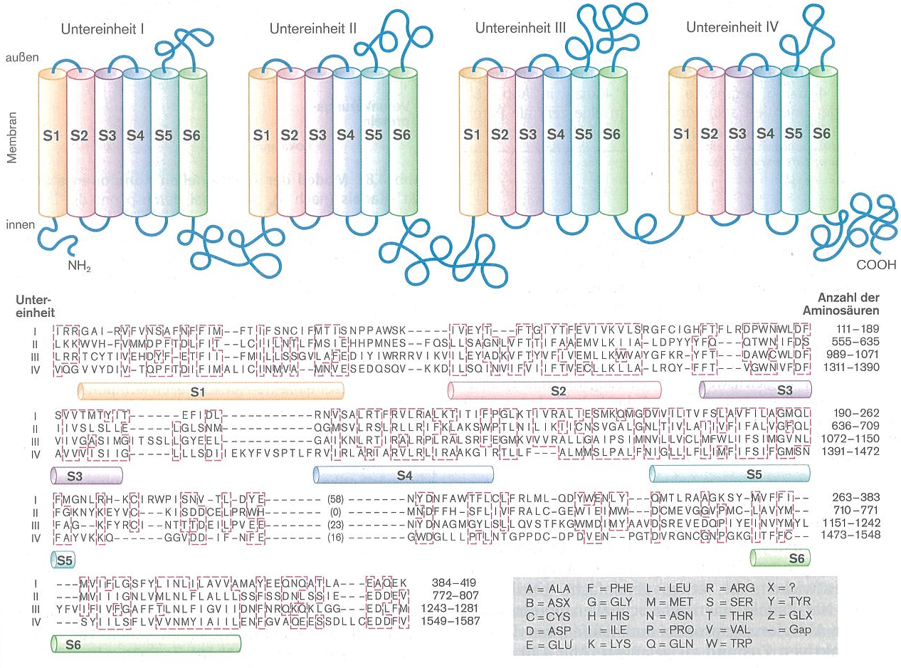
How complicated can an ion channel be?
For instance, a sodium channel looks (schematically!) something like this:

Slide 8
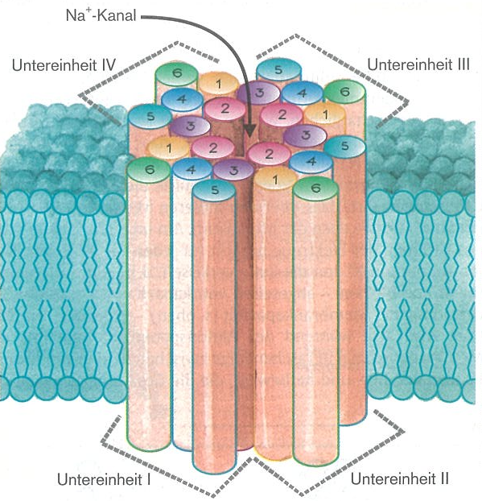

How complicated can an ion channel be?
For instance, a sodium channel looks (schematically!) something like this:

Slide 9
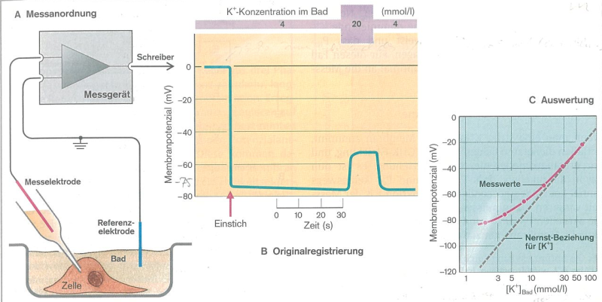
Nernst equation (not considering active ionically selective channels): Semi-permeable membrane – conductance based model
For T=25°C:
(simulation)

Slide 10
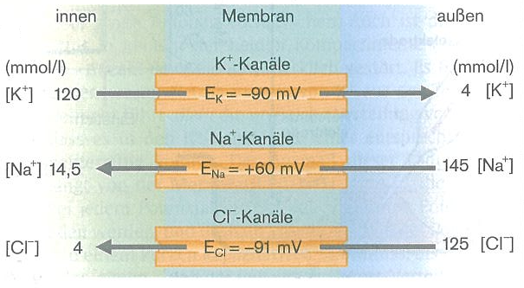
Goldman-Hodgkin-Katz equation:
For a muscle cell
Applies only when Vm is not changing!
For T=37°C:
(simulation)

Slide 11
From permeability to conductance:
In other terms:
Nernst potential:
Ion x conductance:
Ion x current:
c=concentration

Slide 12
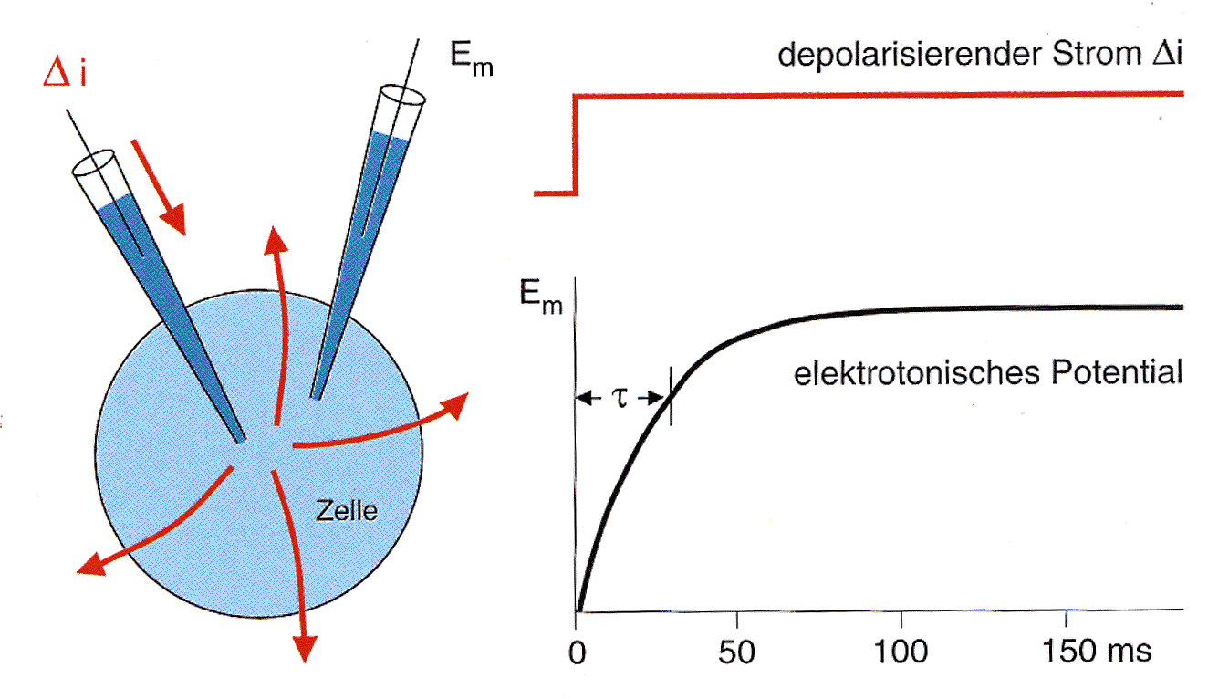
Electrotonic Signal Propagation:
Injected Current
Membrane Potential
Injected current flows out from the cell evenly across the membrane.
Injected current flows out from the cell evenly across the membrane.
The cell membrane has everywhere the same potential.
Injected current flows out from the cell evenly across the membrane.
The cell membrane has everywhere the same potential.
The change in membrane potention follows an exponential with time constant: τ = RC

Slide 13
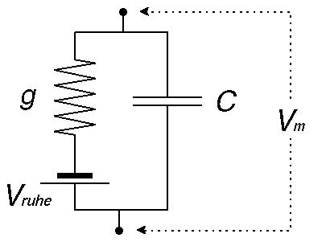
Membrane - Circuit diagram:
Conductance (=1/Resistance) and capacitance
rest

Slide 14
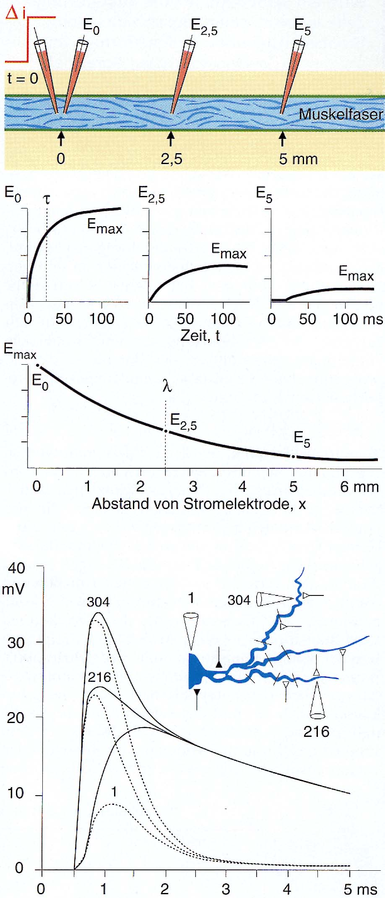
Electrotonic Signal Propagation:
The potential decays along a dendrite (or axon) according to the distance from the current injection site.
The potential decays along a dendrite (or axon) according to the distance from the current injection site.
At every location the temporal response follows an exponential but with ever decreasing amplitude.
The potential decays along a dendrite (or axon) according to the distance from the current injection site.
At every location the temporal response follows an exponential but with ever decreasing amplitude.
If plotting only the maxima against the distance then you will get another exponential.
The potential decays along a dendrite (or axon) according to the distance from the current injection site.
At every location the temporal response follows an exponential but with ever decreasing amplitude.
If plotting only the maxima against the distance then you will get another exponential.
Different shape of the potentials in the dendrite and the soma of a motoneuron.

Slide 15
Membrane - Circuit diagram so far:
So far: Nernst equation (not considering active ion-selective channels): Semi-permeable membrane – conductance based model Now including active channels
rest

Slide 16
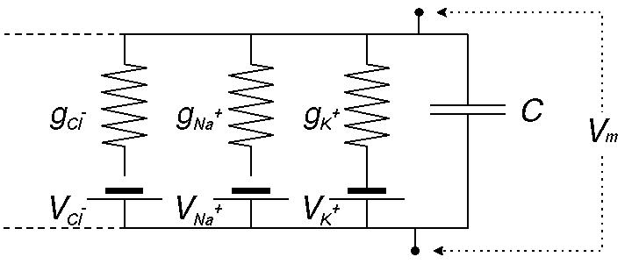
Membrane - Circuit Diagram (advanced version):
The whole thing gets more complicated due to the fact that there are many different ion channels all of which have their own characteristics depending on the momentarily existing state of the cell.
The whole thing gets more complicated due to the fact that there are many different ion channels all of which have their own characteristics depending on the momentarily existing state of the cell.
The conducitvity of a channel depends on the membrane potential and on the concentration difference between intra- and extracellular space (and sometimes also on other parameters).
The whole thing gets more complicated due to the fact that there are many different ion channels all of which have their own characteristics depending on the momentarily existing state of the cell.
The conducitvity of a channel depends on the membrane potential and on the concentration difference between intra- and extracellular space (and sometimes also on other parameters).
One needs a computer simulation to describe this complex membrane behavior.

Slide 17
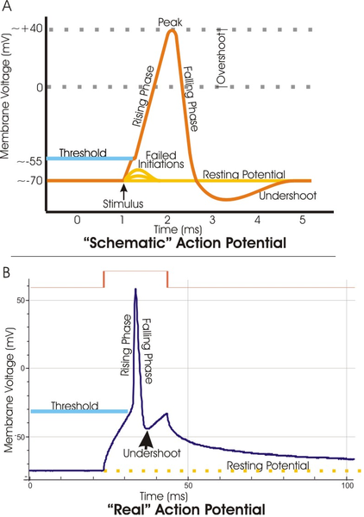
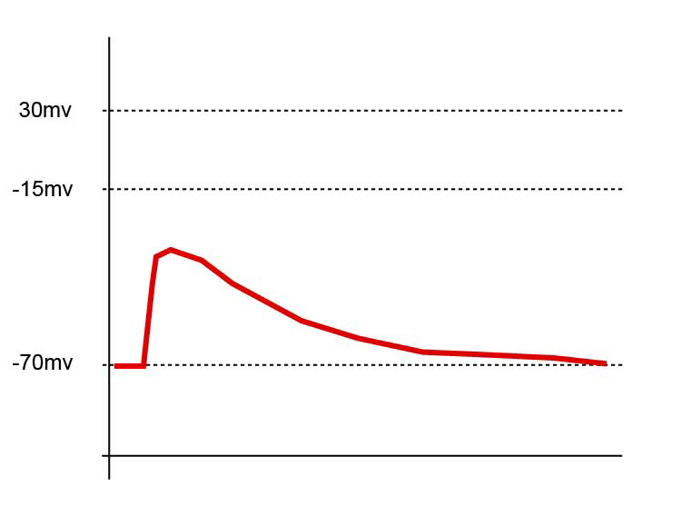
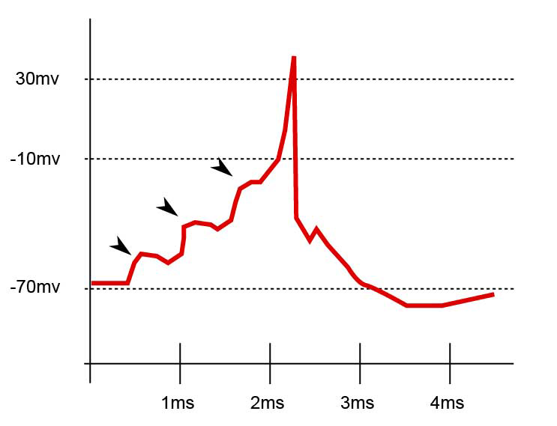
Action potential

Slide 18
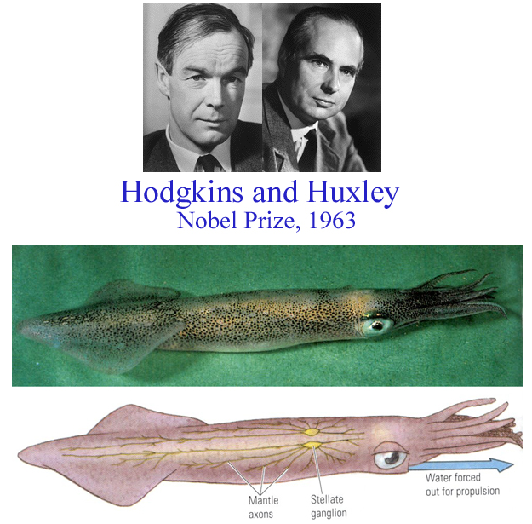
Hodgkin and Huxley
Taken from: http://icwww.epfl.ch/~gerstner/SPNM/node14.html

Slide 19
I ended here

Slide 20
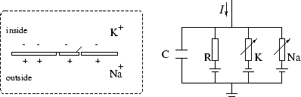
Hodgkin Huxley Model:
charging current
Ion channels
with
and
General Membrane Equation (a very important Equation, used everywhere!)

Slide 21
Hodgkin Huxley Model:
Introducing time-dependence so as to get an Action Potential modelled
Following Hodgkin and Huxley (using rising AND falling functions):
Resulting time-dependent Membrane Equation

Slide 22
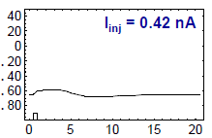
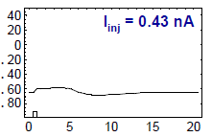
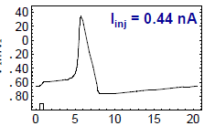
Action Potential / Threshold:
Short, weak current pulses depolarize the cell only a little.
V (mV)
V (mV)
V (mV)
An action potential is elicited when crossing the threshold.
t (ms)

Slide 23
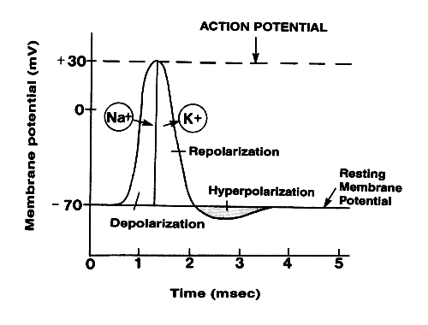
Action Potential

Slide 24
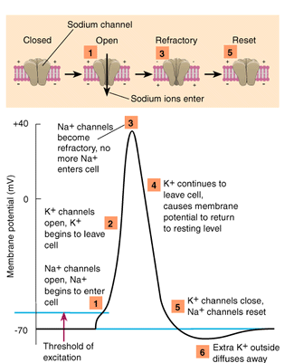
Action Potential

Slide 25
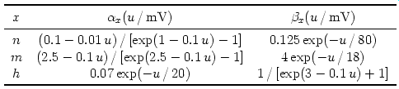
Hodgkin Huxley Model:
voltage dependent gating variables
asymptotic value
time constant
with
(u)
x
(for the giant squid axon)

Slide 26
Solution:
Derivative
=

Slide 27
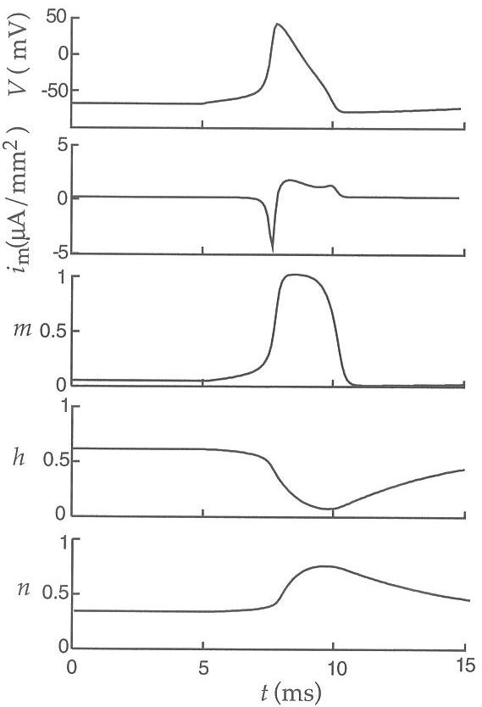
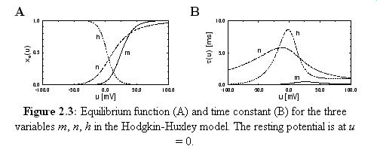
action potential
If u increases, m increases -> Na+ ions flow into the cell
at high u, Na+ conductance shuts off because of h
h reacts slower than m to the voltage increase
K+ conductance, determined by n, slowly increases with increased u

Slide 28
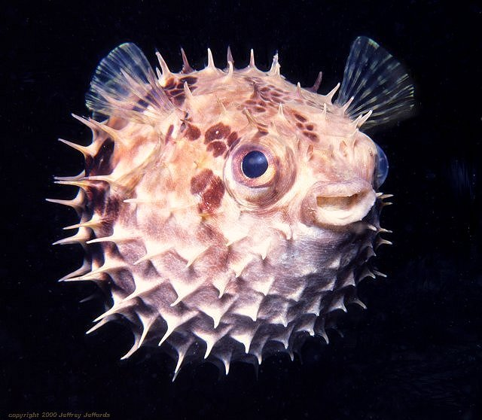
Your neurons surely don‘t like this guy!

Slide 29
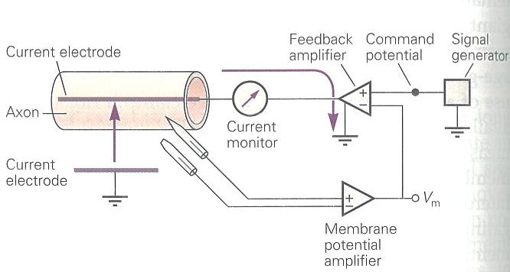
Voltage clamp method
developed 1949 by Kenneth Cole
used in the 1950s by Alan Hodgkin and Andrew Huxley to measure ion current while maintaining specific membrane potentials

Slide 30
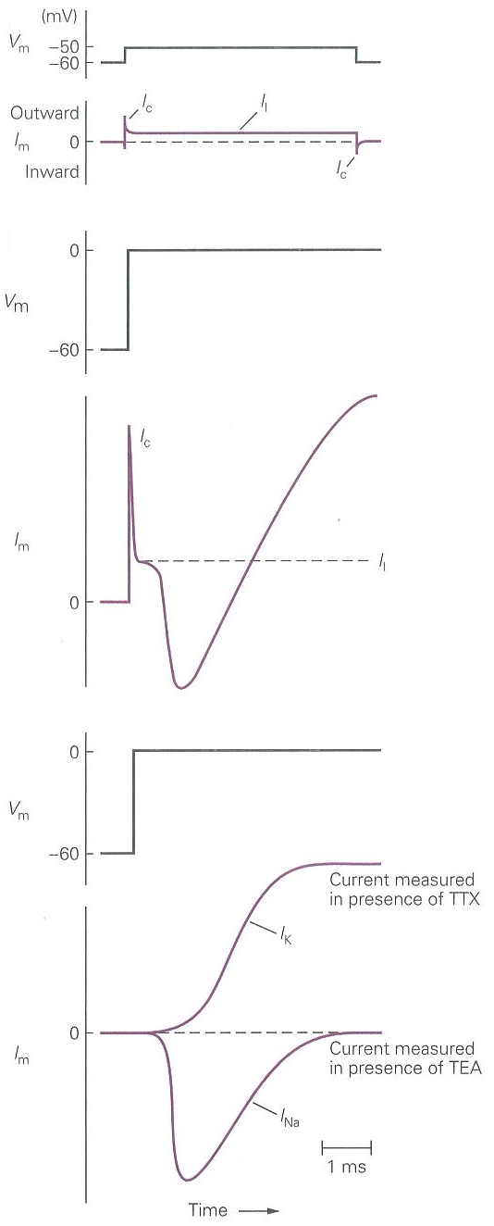
Voltage clamp method
Large depolarization
Small depolarization
Ic: capacity current
Il: leakage current

Slide 31
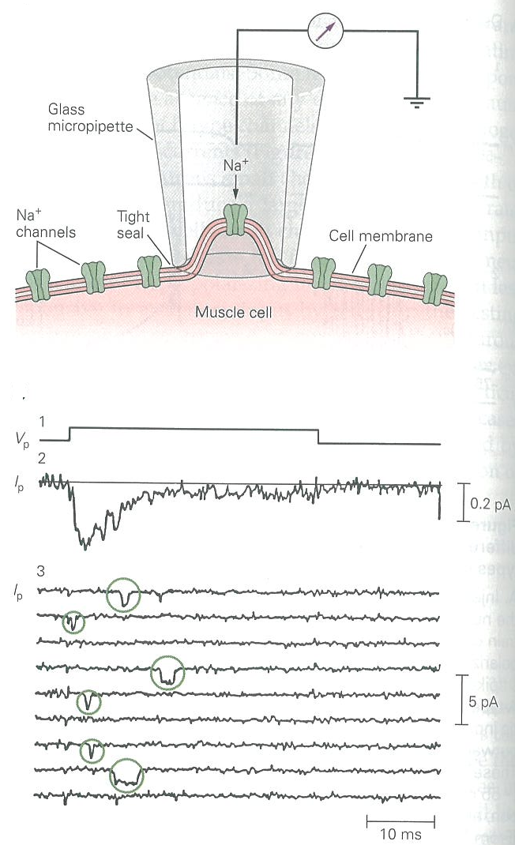
The sodium channel (patch clamp)

Slide 32
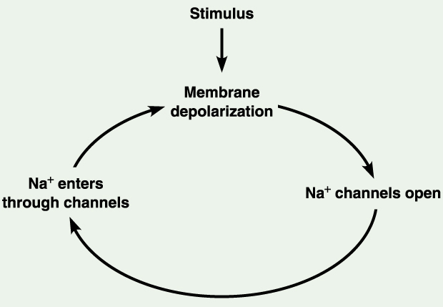
The sodium channel

Slide 33
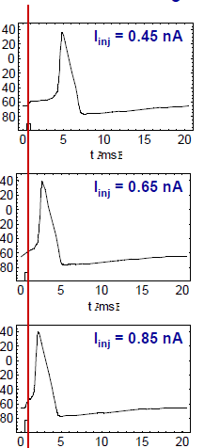
Action Potential / Firing Latency:
A higher current reduces the time until an action potential is elicited.
V (mV)
V (mV)
V (mV)
t (ms)

Slide 34
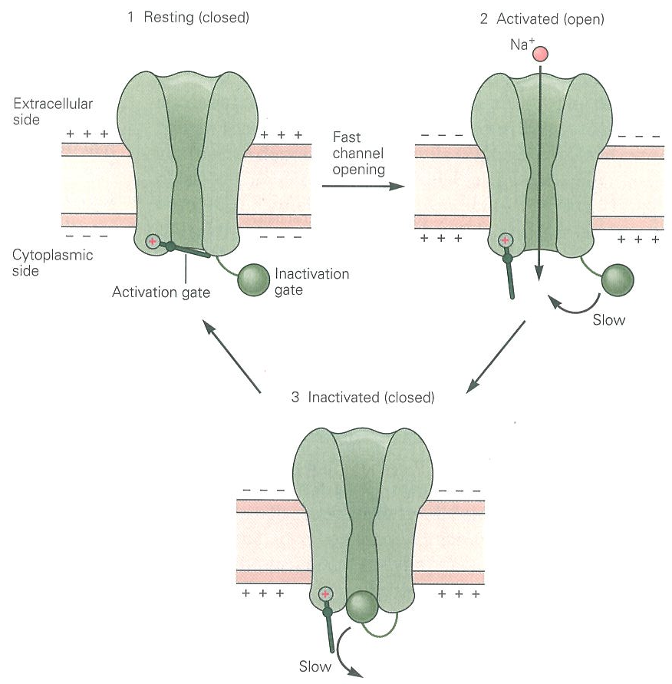
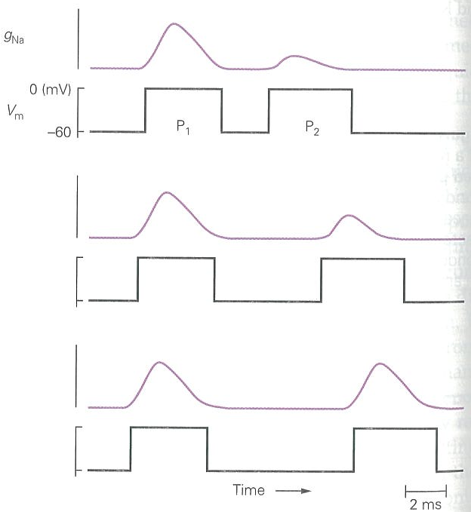
Function of the sodium channel

Slide 35
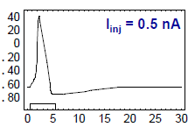
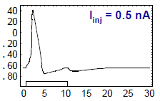
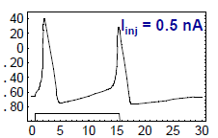
Action Potential / Refractory Period:
Longer current pulses will lead to more action potentials.
Longer current pulses will lead to more action potentials.
However, directly after an action potential the ion channels are in an inactive state and cannot open. In addition, the membrane potential is rather hyperpolarized. Thus, the next action potential can only occur after a “waiting period” during which the cell return to its normal state.
Longer current pulses will lead to more action potentials.
However, directly after an action potential the ion channels are in an inactive state and cannot open. In addition, the membrane potential is rather hyperpolarized. Thus, the next action potential can only occur after a “waiting period” during which the cell return to its normal state.
This “waiting period” is called the refractory period.
V (mV)
V (mV)
V (mV)
t (ms)

Slide 36
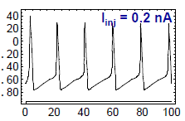
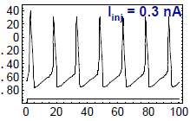
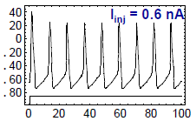
Action Potential / Firing Rate:
When injecting current for longer durations an increase in current strength will lead to an increase of the number of action potentials per time. Thus, the firing rate of the neuron increases.
When injecting current for longer durations an increase in current strength will lead to an increase of the number of action potentials per time. Thus, the firing rate of the neuron increases.
The maximum firing rate is limited by the absolute refractory period.
V (mV)
V (mV)
V (mV)
t (ms)

Slide 37
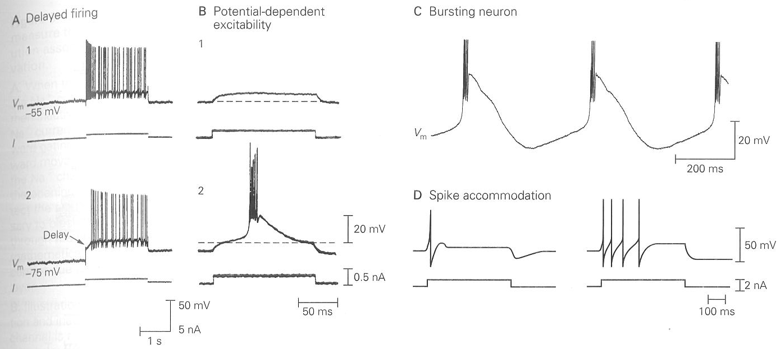
Varying firing properties
Rhythmic burst in the absence of synaptic inputs
Influence of the neurotransmitter Acetylcholin
Influence of steady hyperpolarization

Slide 38
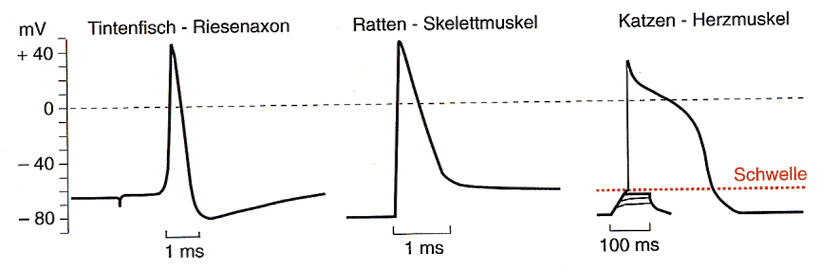
Action Potential / Shapes:
Rat - Muscle
Cat - Heart
Squid Giant Axon

Slide 39
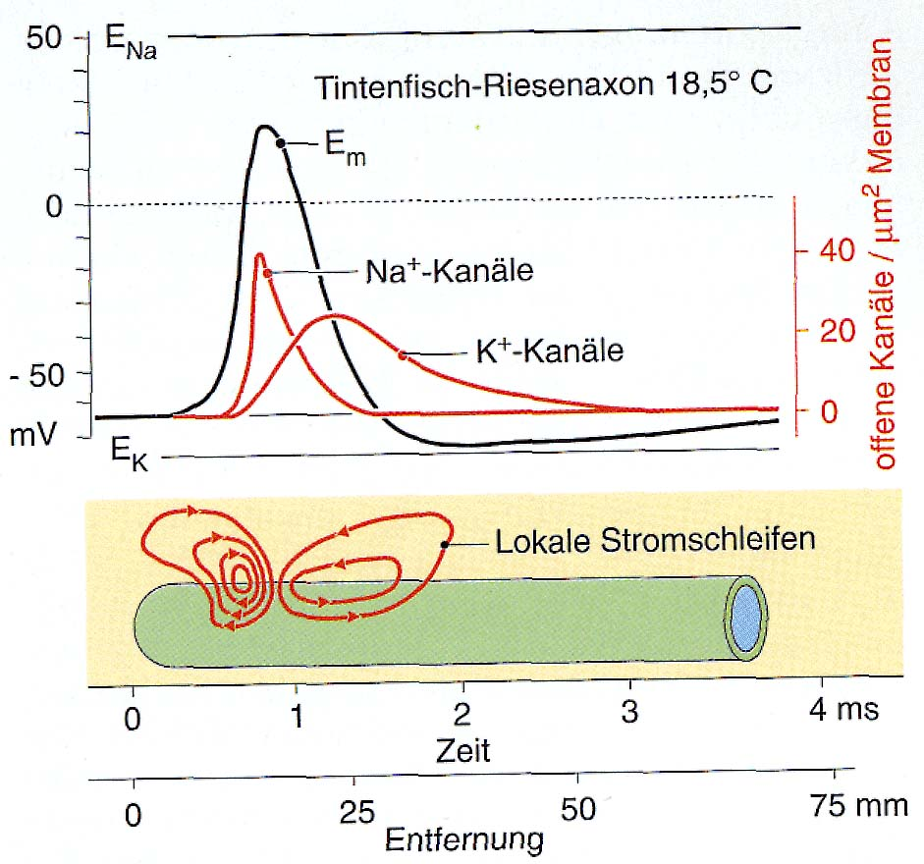
Propagation of an Action Potential:
Action potentials propagate without being diminished (active process).
Action potentials propagate without being diminished (active process).
All sites along a nerve fiber will be depolarized until the potential passes threshold. As soon as this happens a new AP will be elicited at some distance to the old one.
Action potentials propagate without being diminished (active process).
All sites along a nerve fiber will be depolarized until the potential passes threshold. As soon as this happens a new AP will be elicited at some distance to the old one.
Main current flow is across the fiber.
Open channels per
μm² membrane area
Local current loops
Time
Distance

Slide 40
Structure of a Neuron:
At the dendrite the incoming
signals arrive (incoming currents)
At the soma current
are finally integrated.
At the axon hillock action potential
are generated if the potential crosses the
membrane threshold
The axon transmits (transports) the
action potential to distant sites
CNS
At the synapses are the outgoing signals transmitted onto the dendrites of the target neurons
Systems
Areas
Local Nets
Neurons
Synapses
Molekules

Slide 41
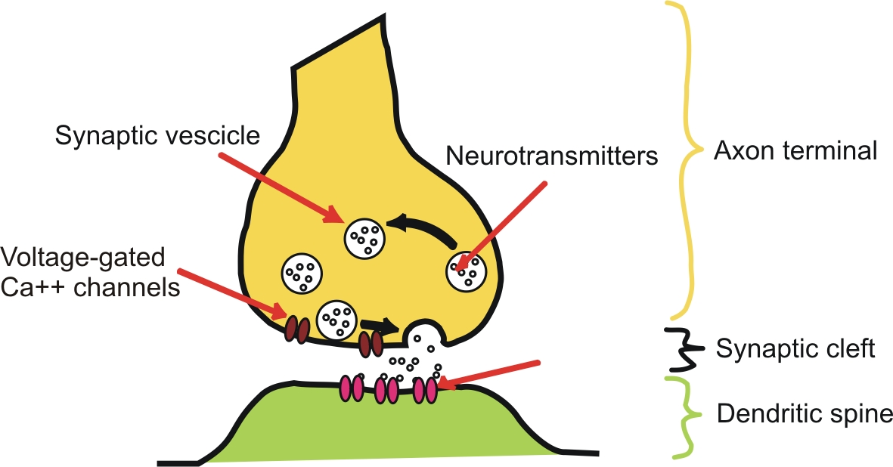
Chemical synapse
Neurotransmitter
Receptors

Slide 42
Neurotransmitters
Chemicals (amino acids, peptides, monoamines) that transmit, amplify and modulate signals between neuron and another cell.
Cause either excitatory or inhibitory PSPs.
Glutamate – excitatory transmitter
GABA, glycine – inhibitory transmitter

Slide 43
Synaptic Transmission:
Synapses are used to transmit signals from the axon of a source to the dendrite of a target neuron.
Synapses are used to transmit signals from the axon of a source to the dendrite of a target neuron.
There are electrical (rare) and chemical synapses (very common)
Synapses are used to transmit signals from the axon of a source to the dendrite of a target neuron.
There are electrical (rare) and chemical synapses (very common)
At an electrical synapse we have direct electrical coupling (e.g., heart muscle cells).
Synapses are used to transmit signals from the axon of a source to the dendrite of a target neuron.
There are electrical (rare) and chemical synapses (very common)
At an electrical synapse we have direct electrical coupling (e.g., heart muscle cells).
At a chemical synapse a chemical substance (transmitter) is used to transport the signal.
Synapses are used to transmit signals from the axon of a source to the dendrite of a target neuron.
There are electrical (rare) and chemical synapses (very common)
At an electrical synapse we have direct electrical coupling (e.g., heart muscle cells).
At a chemical synapse a chemical substance (transmitter) is used to transport the signal.
Electrical synapses operate bi-directional and are extremely fast, chem. syn. operate uni-directional and are slower.
Synapses are used to transmit signals from the axon of a source to the dendrite of a target neuron.
There are electrical (rare) and chemical synapses (very common)
At an electrical synapse we have direct electrical coupling (e.g., heart muscle cells).
At a chemical synapse a chemical substance (transmitter) is used to transport the signal.
Electrical synapses operate bi-directional and are extremely fast, chem. syn. operate uni-directional and are slower.
Chemical synapses can be excitatory or inhibitory
they can enhance or reduce the signal
change their synaptic strength (this is what happens during learning).

Slide 44
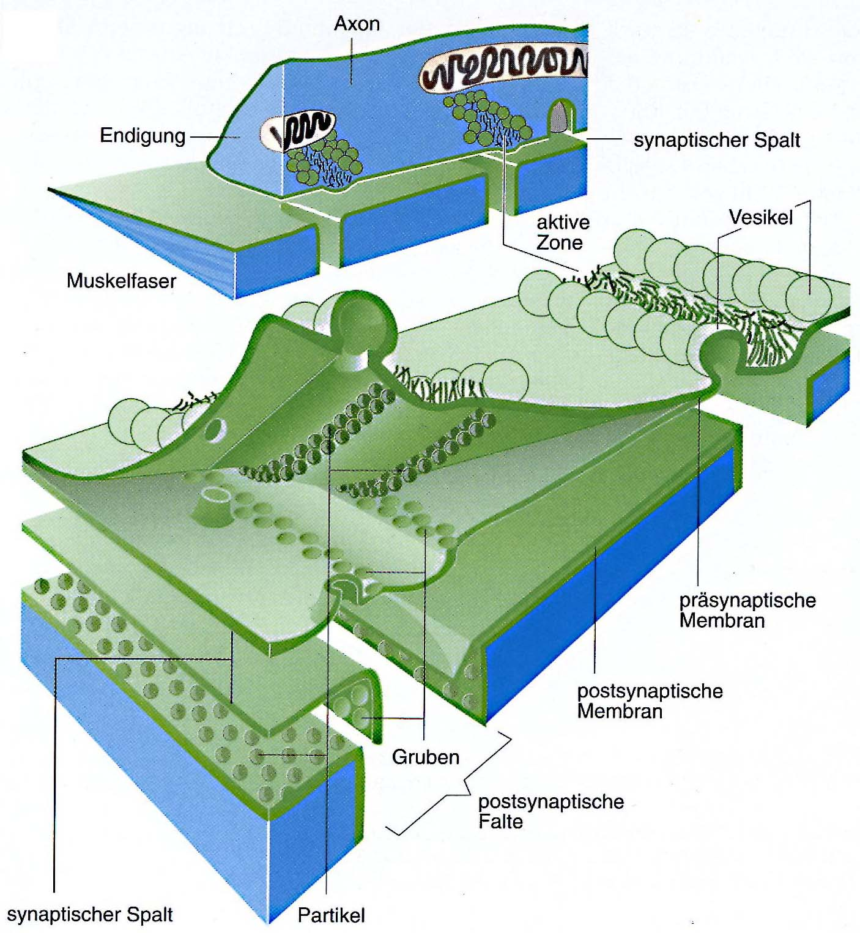
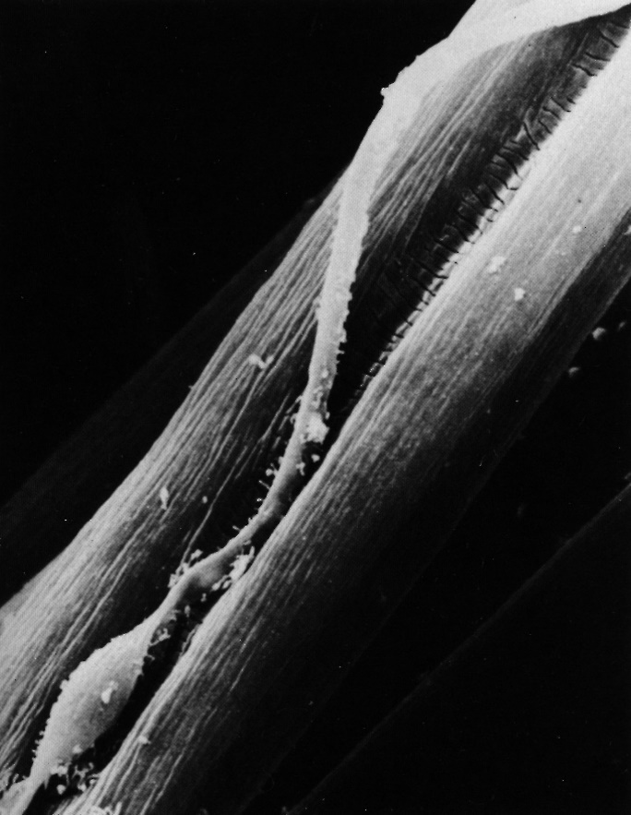
Structure of a Chemical Synapse:
Axon
Motor Endplate
(Frog muscle)
Synaptic cleft
Active
zone
vesicles
Muscle fiber
Presynaptic
membrane
Postsynaptic
membrane
Synaptic cleft

Slide 45
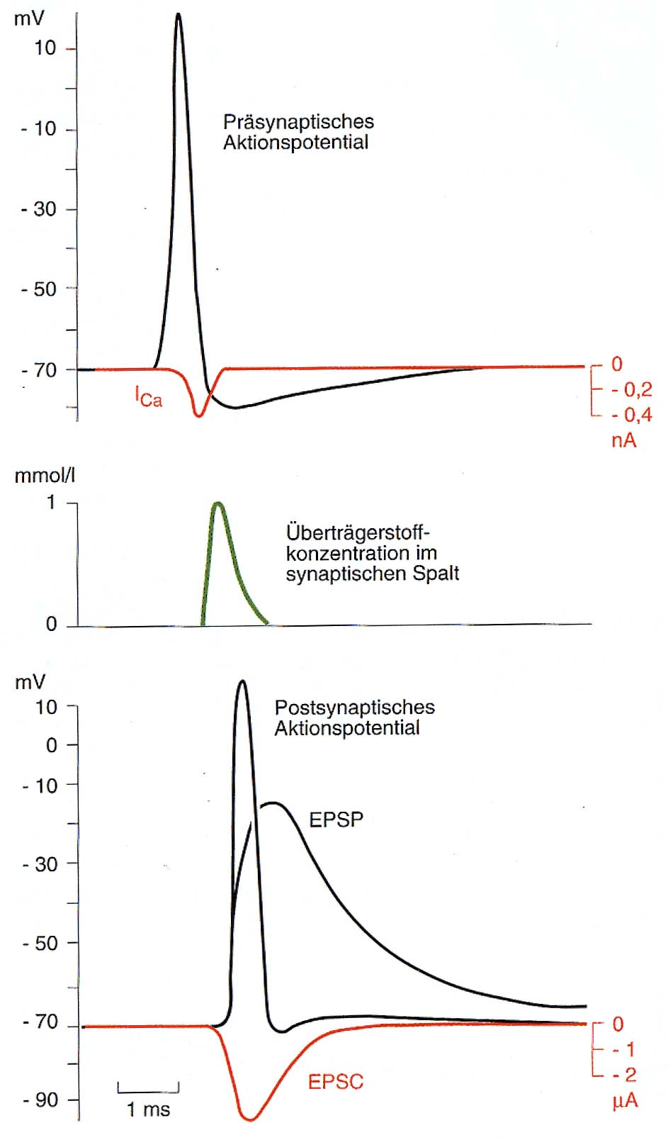
What happens at a chemical synapse during signal transmission:
The pre-synaptic action potential depolarises the axon terminals and Ca²⁺-channels open.
The pre-synaptic action potential depolarises the axon terminals and Ca²⁺-channels open.
Ca²⁺ enters the pre-synaptic cell by which the transmitter vesicles are forced to open and release the transmitter.
The pre-synaptic action potential depolarises the axon terminals and Ca²⁺-channels open.
Ca²⁺ enters the pre-synaptic cell by which the transmitter vesicles are forced to open and release the transmitter.
Thereby the concentration of transmitter increases in the synaptic cleft and transmitter diffuses to the postsynaptic membrane.
The pre-synaptic action potential depolarises the axon terminals and Ca²⁺-channels open.
Ca²⁺ enters the pre-synaptic cell by which the transmitter vesicles are forced to open and release the transmitter.
Thereby the concentration of transmitter increases in the synaptic cleft and transmitter diffuses to the postsynaptic membrane.
Transmitter sensitive channels at the postsyaptic membrane open. Na⁺ and Ca²⁺ enter, K⁺ leaves the cell. An excitatory postsynaptic current (EPSC) is thereby generated which leads to an excitatory postsynaptic potential (EPSP).
Pre-synaptic
action potential
Concentration of
transmitter
in the synaptic cleft
Post-synaptic
action potential

Slide 46
Neurotransmitters and their (main) Actions:
Transmitter Channel-typ Ion-current Action
Transmitter Channel-typ Ion-current Action
Acetylecholin nicotin. Receptor Na⁺ and K⁺ excitatory
Transmitter Channel-typ Ion-current Action
Acetylecholin nicotin. Receptor Na⁺ and K⁺ excitatory
Glutamate AMPA / Kainate Na⁺ and K⁺ excitatory
Transmitter Channel-typ Ion-current Action
Acetylecholin nicotin. Receptor Na⁺ and K⁺ excitatory
Glutamate AMPA / Kainate Na⁺ and K⁺ excitatory
GABA GABA_{A}-Receptor Cl⁻ inhibitory
Transmitter Channel-typ Ion-current Action
Acetylecholin nicotin. Receptor Na⁺ and K⁺ excitatory
Glutamate AMPA / Kainate Na⁺ and K⁺ excitatory
GABA GABA_{A}-Receptor Cl⁻ inhibitory
Glycine Cl⁻ inhibitory
Transmitter Channel-typ Ion-current Action
Acetylecholin nicotin. Receptor Na⁺ and K⁺ excitatory
Glutamate AMPA / Kainate Na⁺ and K⁺ excitatory
GABA GABA_{A}-Receptor Cl⁻ inhibitory
Glycine Cl⁻ inhibitory
Acetylecholin muscarin. Rec. - metabotropic, Ca²⁺ Release
Transmitter Channel-typ Ion-current Action
Acetylecholin nicotin. Receptor Na⁺ and K⁺ excitatory
Glutamate AMPA / Kainate Na⁺ and K⁺ excitatory
GABA GABA_{A}-Receptor Cl⁻ inhibitory
Glycine Cl⁻ inhibitory
Acetylecholin muscarin. Rec. - metabotropic, Ca²⁺ Release
Glutamate NMDA Na⁺, K⁺, Ca²⁺ voltage dependent
blocked at resting potential

Slide 47
Synaptic Plasticity

